Slide 1


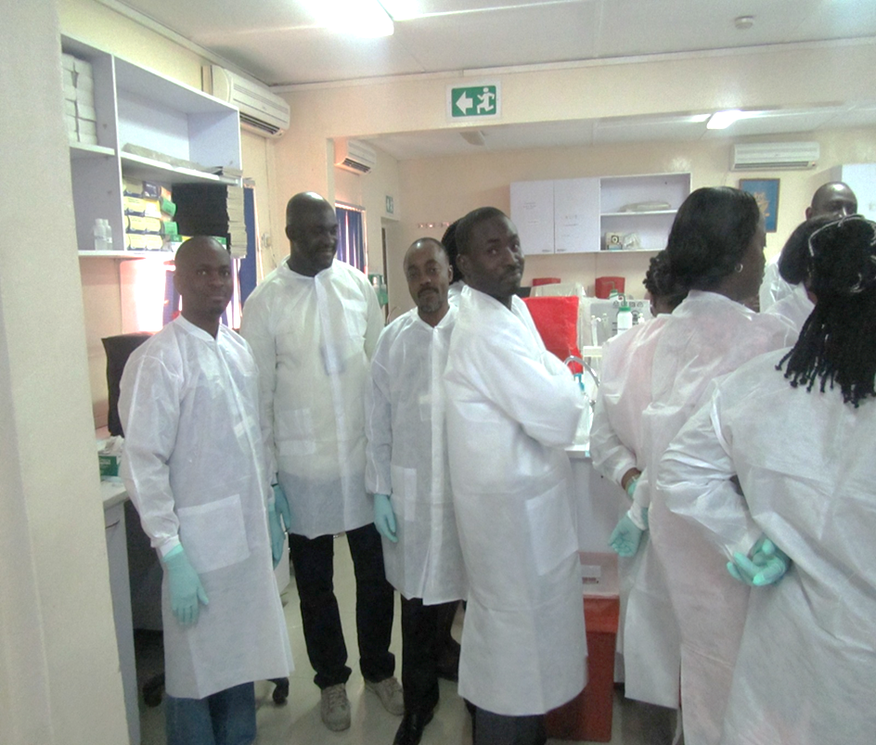
HIV Testing Strategy:
The Nigerian Experience - Expanding Access and Quality
At The RTCQI African Regional Best Practice Workshop, Cape Town South Africa
Date: June 3-7, 2024

Slide 2
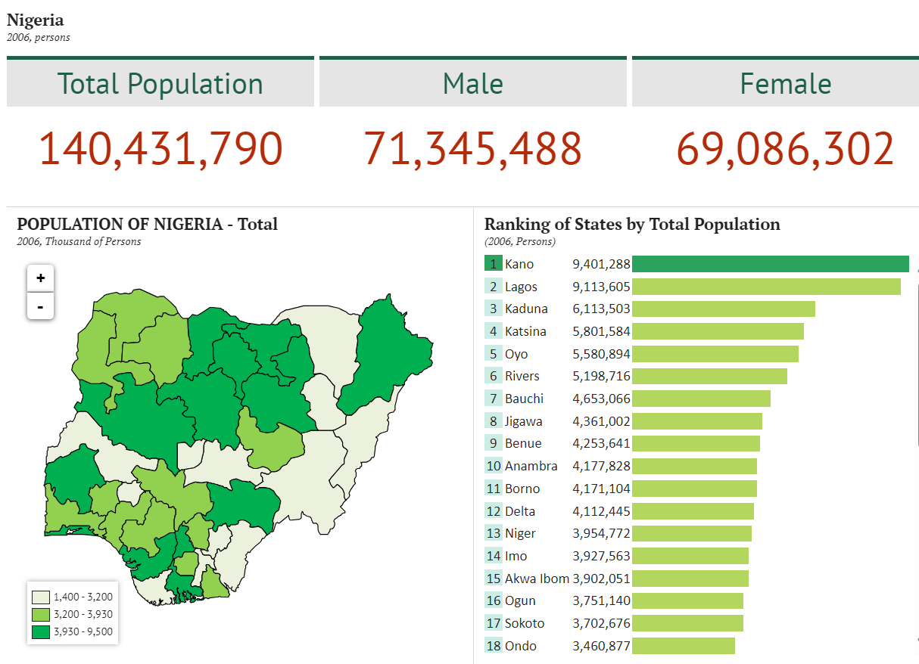
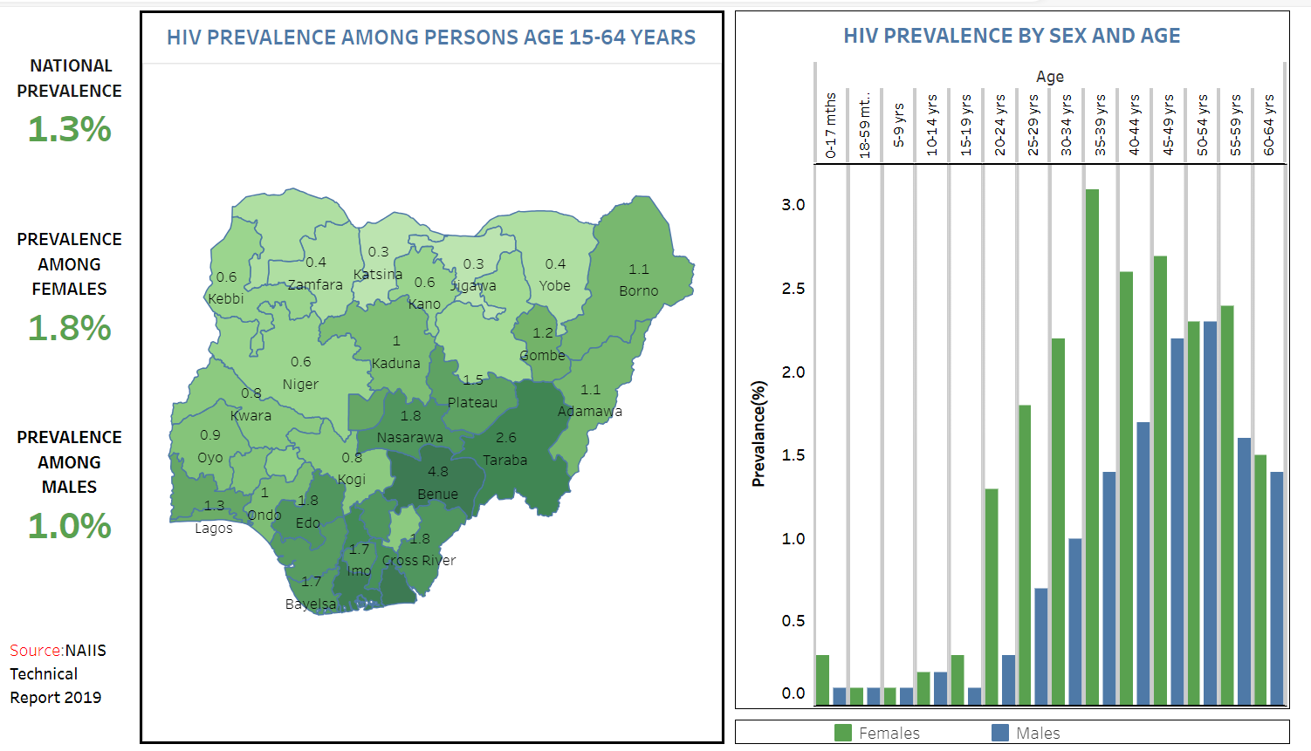
Nigeria: Background and Prevalence
Year | 2006 (National Bureau of Statistics) | 2019 (National Bureau of Statistics) | 2022 Estimate (World Bank)
Population | 140,431,790 | 201,135,262 | 218,541,212
Credit/Sources:
National Bureau of Statistics(2024). Nigeria Total Population. Available: https://nigeria.opendataforafrica.org/bapijf/total-population. Accessed: May 3, 2024
World Bank(2024): Population, total – Nigeria. Available https://data.worldbank.org/indicator/SP.POP.TOTL?end=2022&locations=NG&name_desc=true&start=2022&view=map. Accessed: May 5, 2024
NACA (2024): Nigeria Prevalence Rate. Available: https://naca.gov.ng/nigeria-prevalence-rate/ Accessed: May 11, 2024

Slide 3
Evolution of Testing Strategy
Choice is based on:
Objective of the testing.
Sensitivity & Specificity.
Prevalence in the population to be tested.
Cold-Chain RTK Capillus and Genie II
  Laboratory-based
  Expensive
  Infrastructural needs
  Long TAT (7-14 days)
  Rapid
  Storage at 2-30ºC
  Three Test serial algorithm
  Rapid
  Cold Chain
Non-cold chain RTK
Determine, Uni-Gold, Stat Pak.
EIAs
ELISA and Western Blot

Slide 4
The Journey to a National Algorithm
  No formal HIV rapid tests kits evaluation/national algorithm in Nigeria
Prior to 2005
  A working group was constituted by Government of Nigeria (GoN) to evaluate HIV RTKs
2005
  GoN & PEPFAR completed two phases of evaluation of HIV RTKs
  2006
  The first national HIV (serial) testing algorithm was developed
2007
  Development of alternate Algorithm
  2016
  Harmonize existing algorithms (2007 & 2016) and integrate validated RTKs into a single algorithm.
  2021

Slide 5
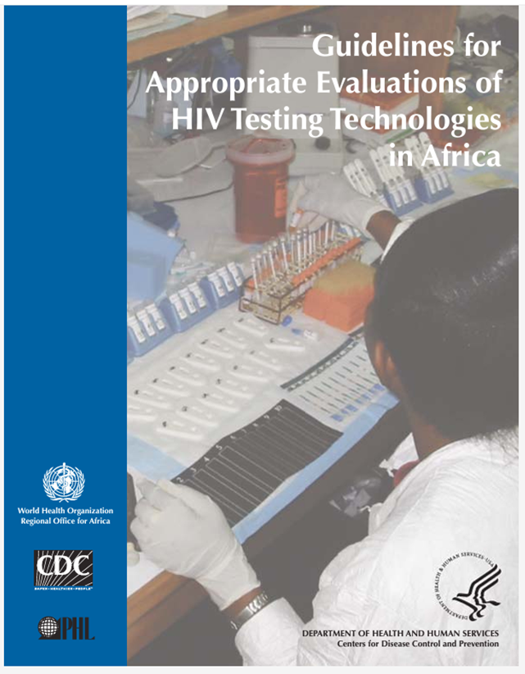
National Algorithm Evaluation and Selection
FMoH (through NASCP) Engage Stakeholders
National Laboratory Quality Assurance Team (NALQAT)
NALQAT
Evaluates RTKs
Make Recommendations to National HIV Laboratory Task Team (NHLTT).
NHLTT
  Review Recommendation and forward to FMoH, through NASCP.
NASCP
  Review Recommendation, adopts and forward to the Hon. Minister of Health.
FMoH – Federal Ministry of Health, Nigeria.
NASCP – National/State HIV/AIDS, Viral Hepatitis and STIs Control Programme
NHLTT – National HIV Laboratory Task Team
NALQAT – National Laboratory Quality Assurance Team
Minister of Health
  Approves Algorithm

Slide 6

Kit Evaluation and Selection Criteria For National Algorithm
Evaluations protocol secured with National Health Research Ethics Committee (NHREC) approval.
RTKs evaluated meets WHO recommendations sensitivity (≥ 99%) and specificity (≥98%).
RTKs with:
  Highest sensitivity are placed for use as first line.
  Highest specificity are placed for use as second line.
  Highest accuracy are placed for use as tie breaker.

Slide 7
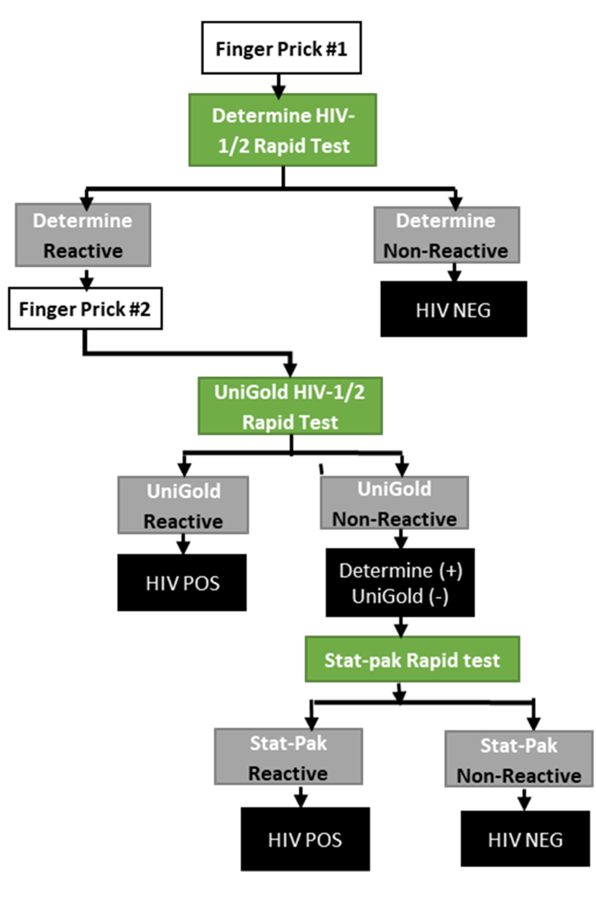
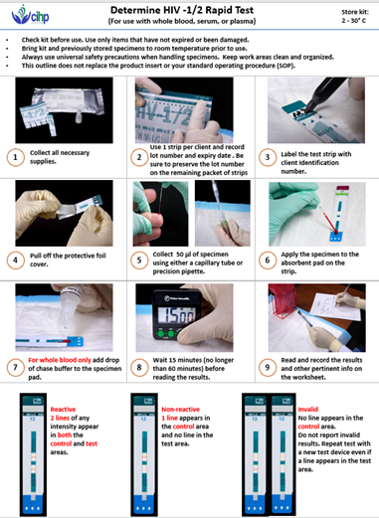

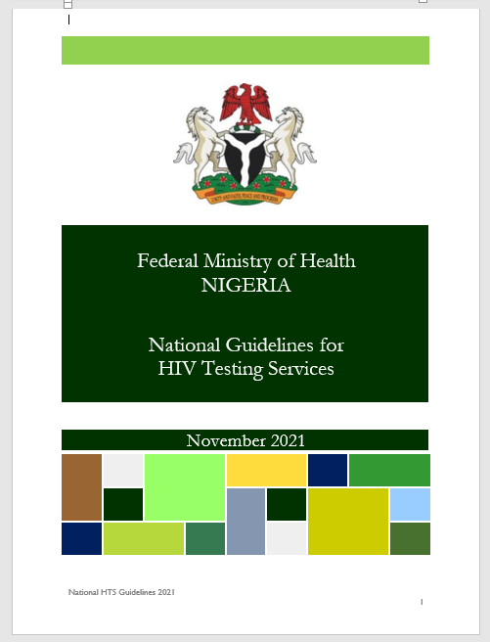
National Algorithm

Slide 8
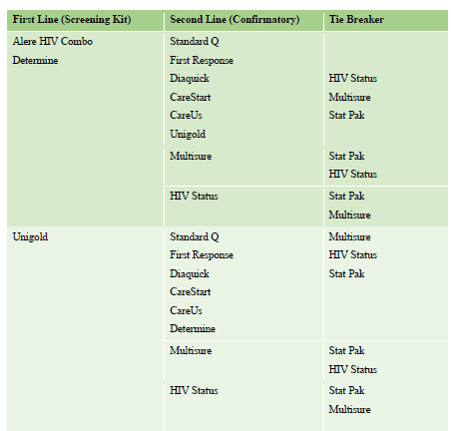
Alternative Algorithm
Nigerian Alternative algorithm is based on multiple RTKs options:
  Increase RTKs options and choices
  Reduce cost without reducing quality (market competition).
  Increase access to HIV testing services.
  Ensure continuity of Testing services when primary algorithm has issues.

Slide 9
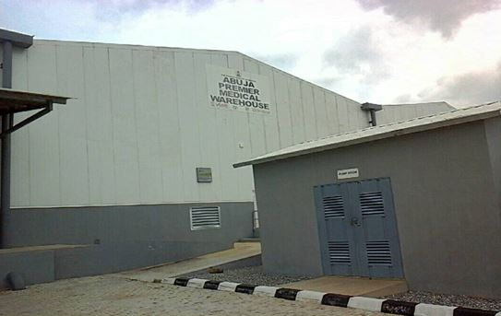
Kits Performance Monitoring
National Algorithm is reviewed every five (5) years.
Post Market Verification (PMV) across two (2) 3,500-square metre warehouses (each):
  Abuja Premier Medical Warehouse
  Lagos Federal Medical Warehouse
Lot-to-lot Validation of RTKs at health facilities.
Weekly quality control at testing sites.

Slide 10
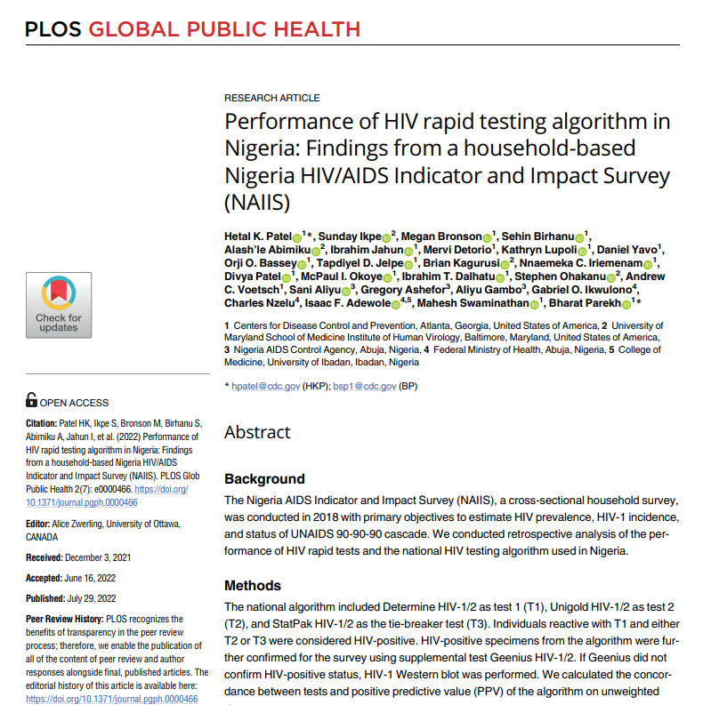
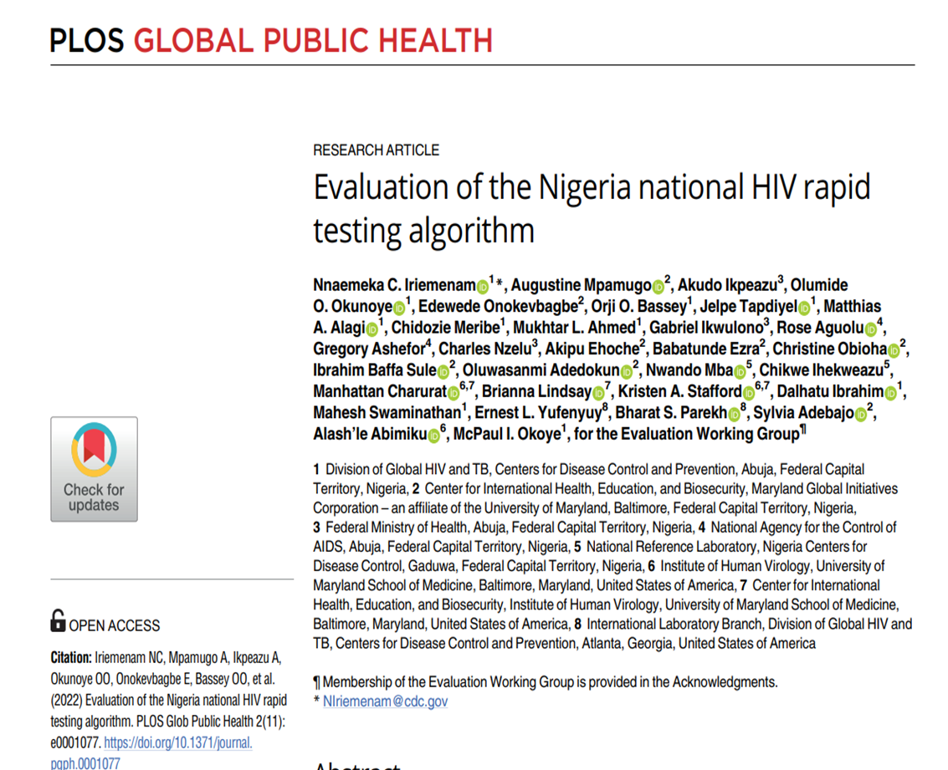
Performance Monitoring

Slide 11

2020 Nigerian HIV Rapid Testing Algorithm Evaluation
WHO recommended sensitivity, PPV, and NPV ≥ 99% and specificity ≥ 98%.
Overall performance of Nigeria national algorithm was found to be consistent with the WHO recommendations.
  Sensitivity: 99.2%,
  Specificity: 99.4%,
  Positive Predictive Value (PPV): 99.0%
  Negative Predictive Value (NPV): 99.5%

Slide 12
Supply Management of HIV Test Kits
Bi-monthly, logistics data flow on National Health Logistics Management Information System (NHLMIS) guiding re-supply
NigerianMedical Record System (NMRS)
Inventory Control Card (ICC)
  Data linked with deidentified patient-level service data.
  Track supply versus utilization
  User friendly with data ingestion and analytics capabilities.
  Health Facility and
  Community Testing
  Electronically captures:
  Receipt
  Utilization
  Adjustment
  Data linked with patient-level service data.
  Track supply versus utilization
  Manually captures:
  Receipt
  Utilization
  Adjustment
HIV Testing Register (Integrated)
Commodity Management Module (CMM)
National Data Repository (NDR)

Slide 13
Expanding Access to HIV Testing – Testing Points & Competent Testers

Slide 14
HIV Retesting Data for Verification of Positives

Slide 15
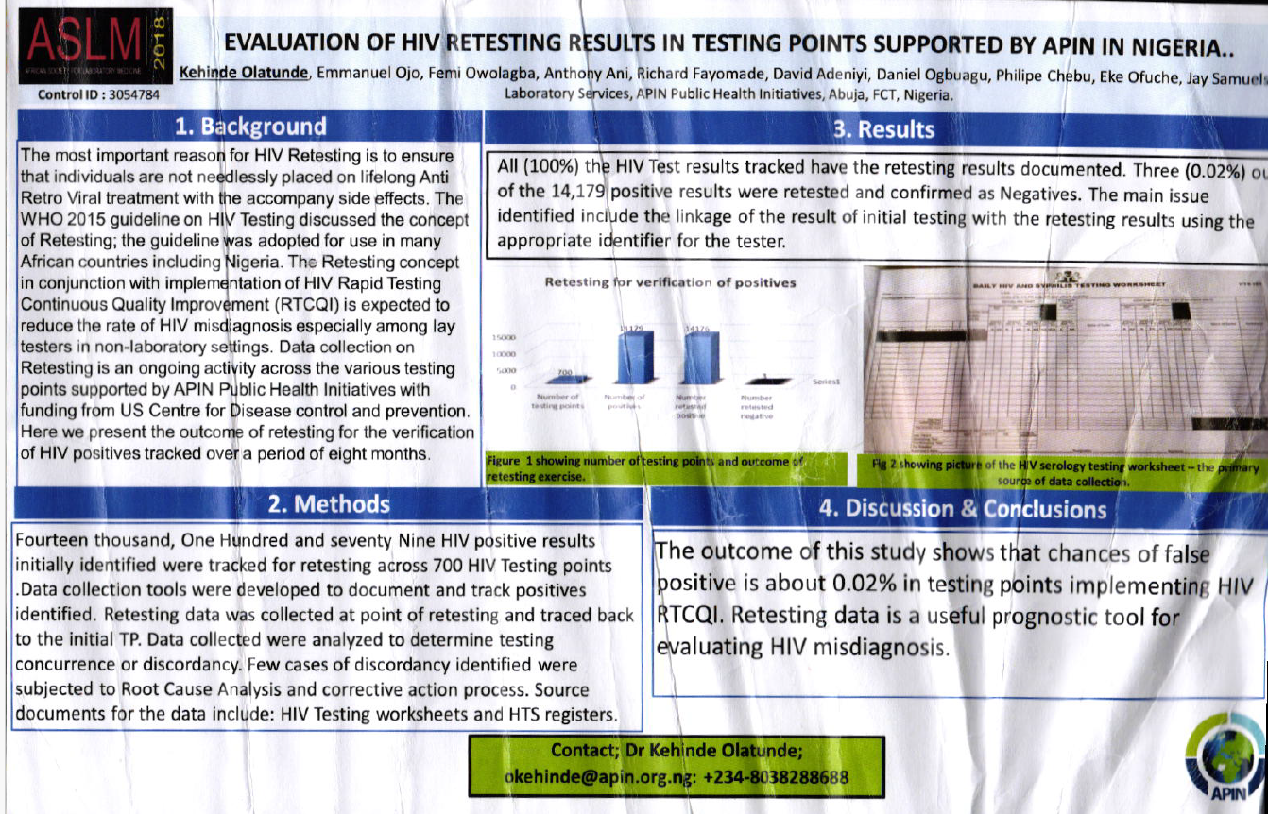
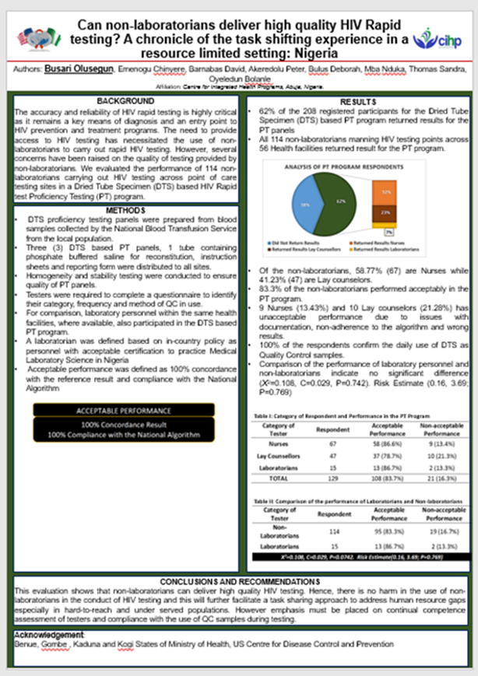
Program Success
Quality assurance maintained during expansion of HIV testing. Active HIV testing points: from 278 (in 2016) to 1, 872 (FY24 SAPR).
Task shifting to lay Counsellor testers.
National algorithm overall performance is consistent with the WHO recommendation.
Over 730,945 clients newly tested with HIV, retested before ART commencement since FY17.
Prevented 528 clients from ‘wrongfully’ placement on ART during retesting for verification of positives.

Slide 16
Program Challenges and Recommended Actions
S/N | Program Challenges | Actions
1. | High attrition among testers. | Continuous Training
2. | Slow paced of Tester’s Certification Programs | Continuous engagement with FMoH Sustained advocacy to SMoH and HMB

Slide 17
Acknowledgement
National HIV/AIDS, Viral Hepatitis and STIs Control Programme (NASCP), Federal Ministry of Health (FMoH), Nigeria.
CDC
APIN-PHI
CCFN
CIHP
ECEWS
IHVN
PHIS3

Slide 18
It is a rapid test, but it may not be as simple, as presumed.
…RTCQI Assures Quality
Thank you

